Slide 1
Stacks and Queues
CS 240 Spring 2019

Slide 2
ADTs describe behavior
Recall that ADTs describe a Data Structure’s behavior, not its implementation
This means that a specific ADT should have a conventional interface, but implementation can vary greatly

Slide 3
The Stack
What if we need a Collection Data Structure...
but we want to restrict how the data is accessed...
and it must also be a Sequential data structure

Slide 4
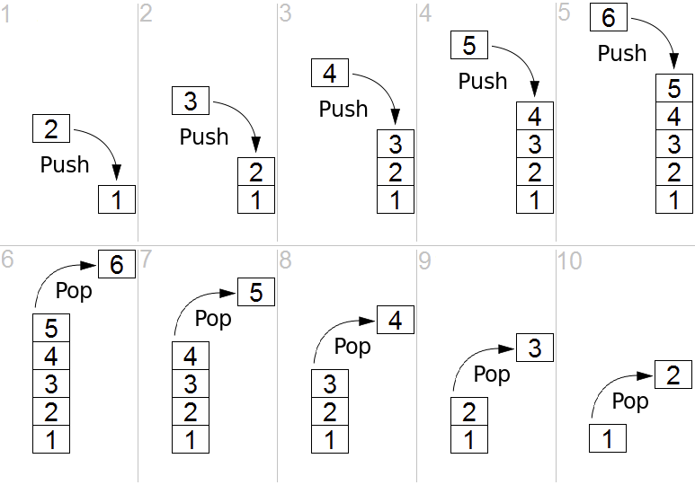
LIFO
Last in First Out
Stacks limit the user to removing elements in reverse order of their insertion
Stack of books in a box

Slide 5
Push / Pop
Push
Inserting onto a stack is called a push
Pop
Removing from the stack is called pop
To access an element, you must take every element before it off the stack

Slide 6
Stack ADT Interface
class Stack { // Stack class ADT
void clear(); // Reinitialize the stack.
boolean push(Object it); // Push "it" onto the top of the stack
Object pop(); // Remove and return the element at the top of the stack
Object peek(); // Return a copy of the top element
};

Slide 7
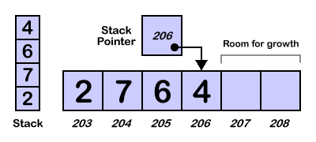
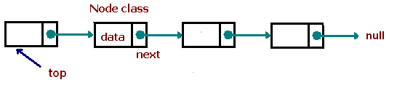
Two Implementations
Array Based
top - an index pointing to the ‘top’ of the list
the initialization size
pros
easier memory management
cons
requires a static size
Linked Based
Use linked list as the underlying data structure
pros
internal memory is dynamic
cons
more complex memory management

Slide 8
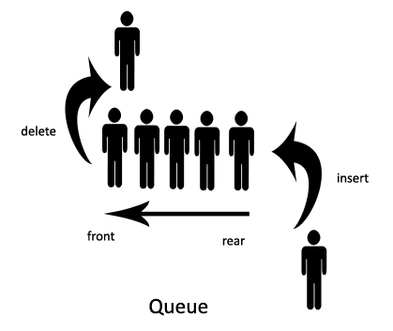
Queue
What if we need something similar to a stack but we want our access in insertion order
First in First Out

Slide 9
Dequeue / Enqueue
Enqueue
Inserting onto a queue is called an enqueue
Dequeue
Removing from the stack is called dequeue
To access an element, you must take every element before it off

Slide 10
Queue Public Interface
class Queue { // Queue class ADT
void clear(); // Reinitialize the Queue.
boolean enqueue(Object it); // Push "it" into the Queue
Object dequeue(); // Remove and return the element at the end of the Queue
Object peek(); // Return a copy of the oldest element
}

Slide 11
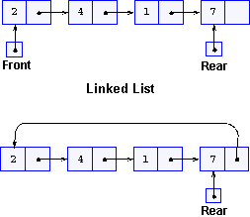
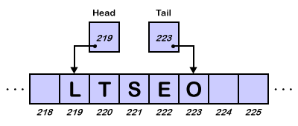
Two Implementations
Array Based
top and bottom - an index pointing to the ends of the list
need initial size
pros
easier memory management
cons
requires a static size
Linked Based
Can use your existing linked list as the underlying data structure
pros
internal memory is dynamic
cons
more complex memory management

Slide 12
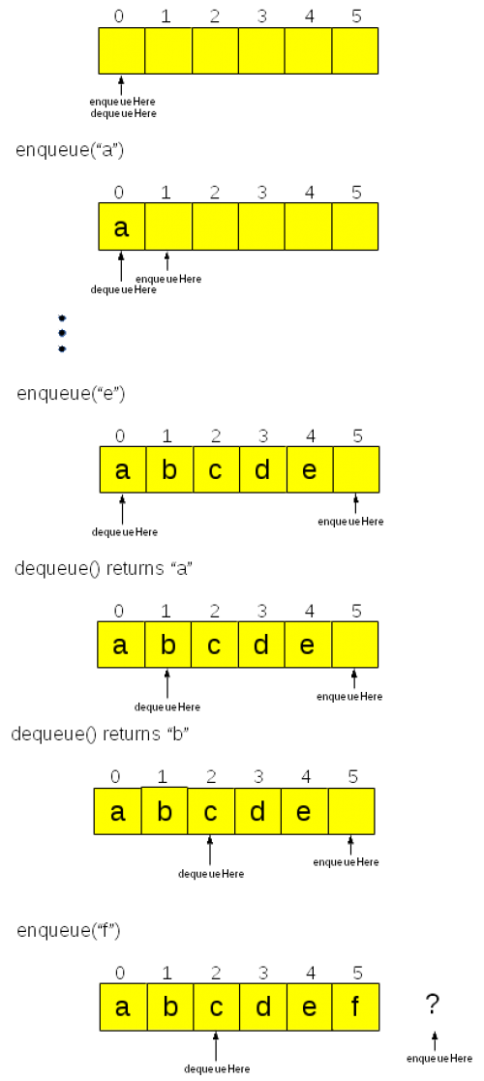
Array Based Queue Implementation

Slide 13
Classwork:
Stacks and Queues

